Slide 1
TOPICS IN COMPUTER SCIENCE
BINARY SEARCH
YURA JO

Slide 2
INTRODUCTION
Input
: In the first row, n integers are arranged in ascending order are input. (-1 billion ~ 1 billion)
In the second row, m integers are input. (-1 billion ~ 1 billion)
output
: find the index of the target value in sorted data.
each result is separated by blanks and output on one line.
Assume that the first item of the list is stored at index 0 and the last item is at index N-1.
If the value is not found, output -1.
ex) input : 1 2 3 4 5
-5 5 2
output : -1 4 1

Slide 3
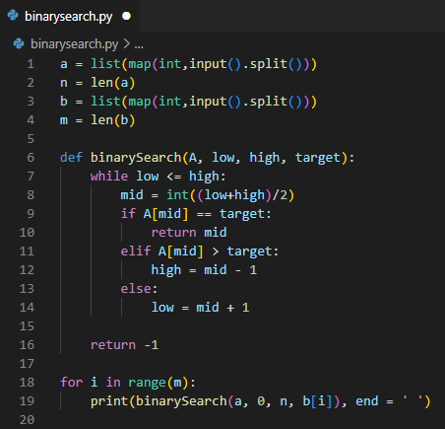
CODES
map(function, iterable)
input().split()
: Separating input values based on spaces
len(L) : the number of items in a list
end = '[delimiter]'
: prints a phrase with the print function, and can be set to a value other than \n at the end.

Slide 4
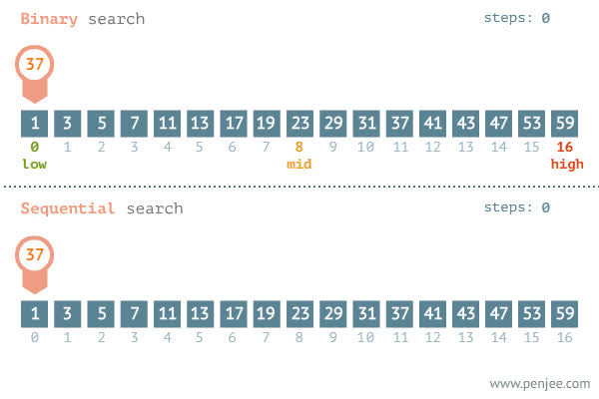
CODES
Change the[mid] by using if statements
used while to make a loop
used range to find all the index in list b

